Slide 1

Introducing Hooks

Slide 2
Objectives
Describe about Hooks? Rule of Hooks?
Describe about Built-in Hooks, Custom Hooks
Maintaining state using Hooks
Performing initialization and cleanup actions
Sharing data using context Hooks
Using reducer Hooks to scale state management

Slide 3
What are Hooks?
Hooks are functions that are part of the React library.
React didn’t have a simple way to share reusable functionality between components
=> Solutions such as higher-order components and render props.
Using classes to be unnecessarily confusing and verbose.
Hooks give the ability to accomplish the same thing with less code and to split up your components into smaller parts by creating custom hooks.

Slide 4
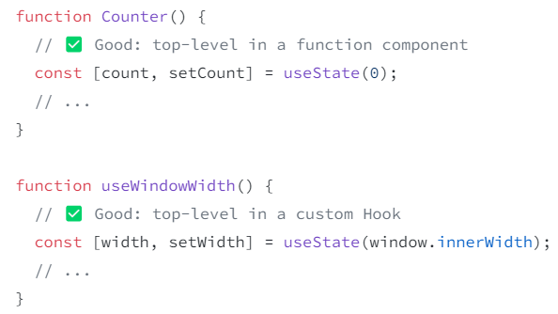
Rules of Hooks
Three important rules which must be followed:
You might be breaking the Rules of Hooks.
You might have mismatching versions of React and React DOM.
You might have more than one copy of React in the same app.
View more: https://react.dev/warnings/invalid-hook-call-warning

Slide 5

Built-in Hooks
Basic Hooks
useState: This functional component is used to set and retrieve the state.
useEffect: It enables for performing the side effects in the functional components.
useContext: It is used for creating common data that is to be accessed by the components hierarchy without having to pass the props down to each level

Slide 6
Built-in Hooks – cont’d
Additional Hooks:
useReducer: used when there is a complex state logic that is having several sub-values or when the upcoming state is dependent on the previous state. It will also enable you to optimization of component performance that will trigger deeper updates as it is permitted to pass the dispatch down instead of callbacks.
useCallback: This is useful while passing callbacks into the optimized child components and depends on the equality of reference for the prevention of unneeded renders
useMemo: This will be used for recomputing the memoized value when there is a change in one of the dependencies. This optimization will help for avoiding expensive calculations on each render

Slide 7
Built-in Hooks – cont’d
Additional Hooks – cont’d:
useRef: permit creating a reference to the DOM element directly within the functional component.
useImperativeHandle: enable modifying the instance that will be passed with the ref object.
useLayoutEffect: used for the reading layout from the DOM and re-rendering synchronously.
useDebugValue: used for displaying a label for custom hooks in React DevTools.

Slide 8
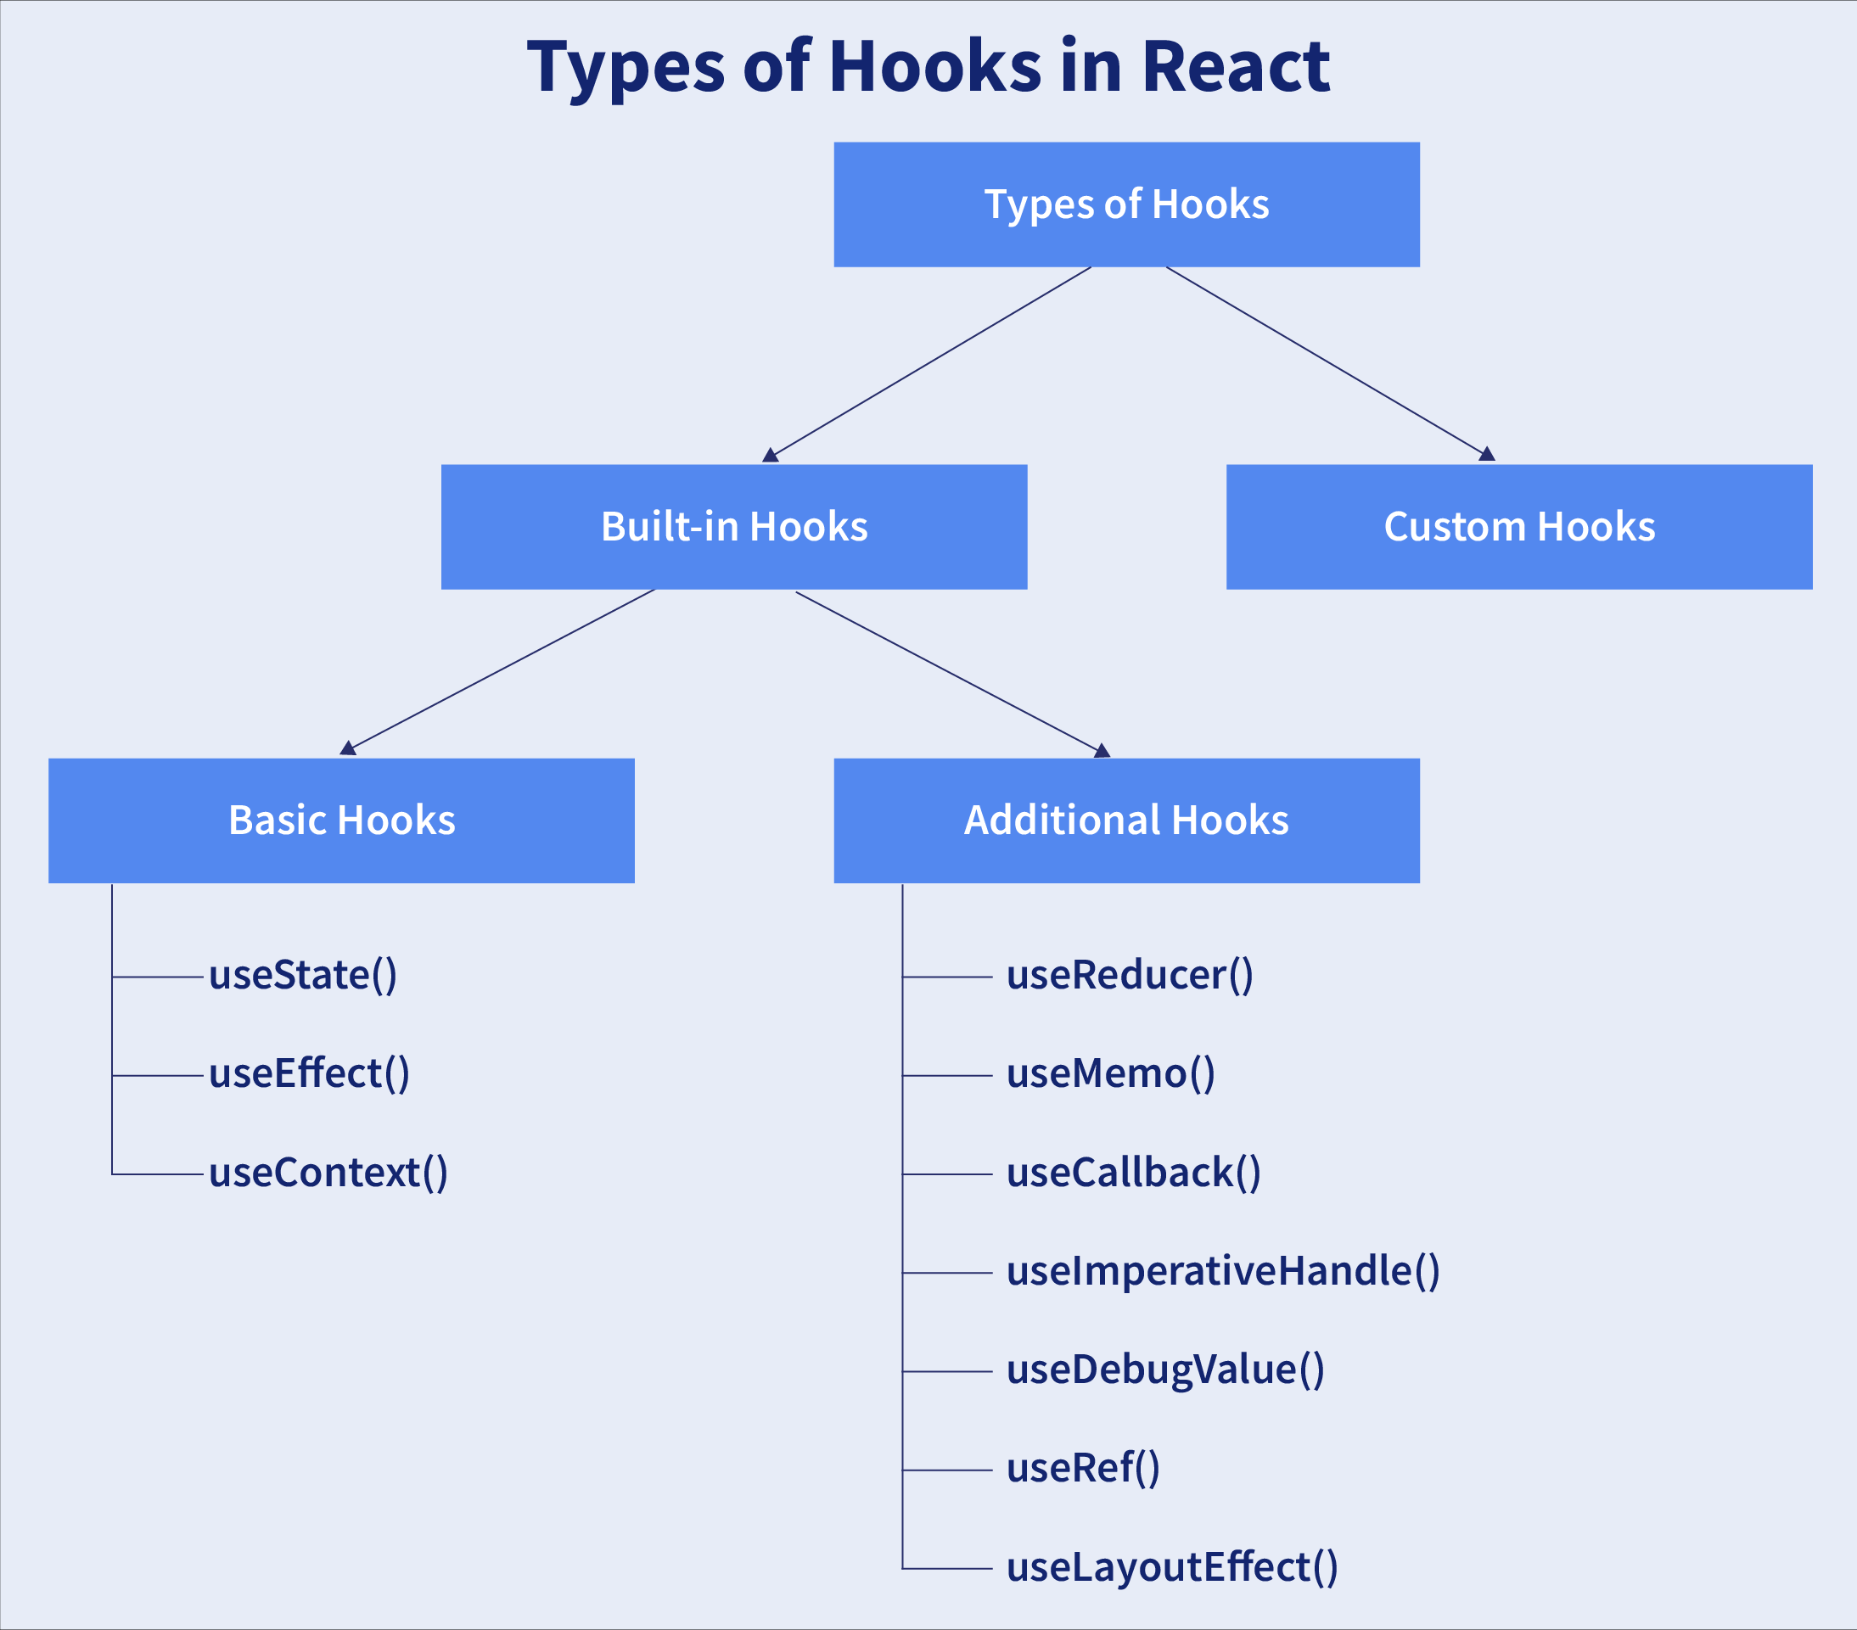
Custom Hooks
It is basically a function of JavaScript.
It is similar to a regular function.
The “use” at the beginning of the Custom Hook Name is required.
Moreover, custom Hooks will enable for extracting component logic from within reusable functions.

Slide 9
Differentiate React Hooks vs Classes
React Hooks | Classes
It is used in functional components of React. | It is used in class-based components of React.
It will not require a declaration of any kind of constructor. | It is necessary to declare the constructor inside the class component.
It does not require the use of this keyword in state declaration or modification. | Keyword this will be used in state declaration (this.state) and in modification (this.setState()).
It is easier to use because of the useState functionality. | No specific function is available for helping us to access the state and its corresponding setState variable.
React Hooks can be helpful in implementing Redux and context API. | Because of the long setup of state declarations, class states are generally not preferred.

Slide 10
Maintaining state using Hooks
The first React Hook API that we'll look at is called useState(), which enables your functional React components to be stateful.
Before Hooks were introduced to React, our only option for creating stateful components was to use a class so that we could access the setState() method.
useState include:
Initial state values
Updating state values

Slide 11
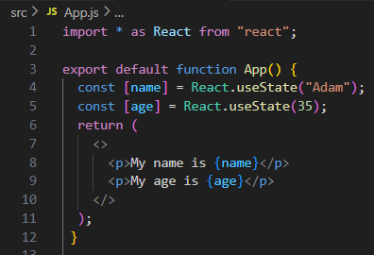
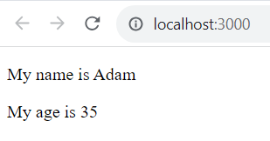
Maintaining state using Hooks – cont’d
Initial state values:
When components are first rendered, they probably expect some state values to be set. This is called the initial state of the component, and we can use the useState() Hook to set the initial state.

Slide 12
Maintaining state using Hooks – cont’d
Updating state values:
React components use state for values that change over time.
For example, the server responds to an API request with new data, or the user has clicked a button or changed a form field.
With functional components that use the useState() Hook, state values are updated differently to class components that rely on the setState() method.
The useState() Hook returns an array. The first item is the state value and the second is the function used to update the value.

Slide 13
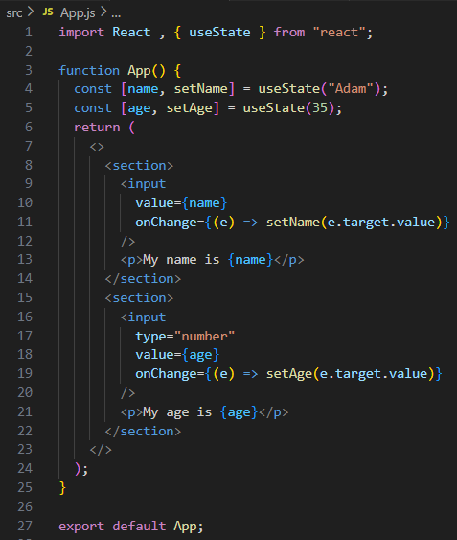
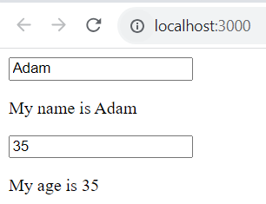
Maintaining state using Hooks – cont’d
Updating state values – cont’d

Slide 14
Exercise 12: Demo about useState() Hook

Slide 15
Performing initialization and cleanup actions
React components need to perform actions when the component is created.
For example, a common initialization action is to fetch API data that the component needs. Another common action is to make sure that any pending API requests are canceled when the component is removed.
About the useEffect() Hook and how it can help you with these two scenarios.
useEffect include:
Fetching component data.
Canceling requests and resetting state.
Optimizing side-effect actions.

Slide 16
Performing initialization and cleanup actions – cont’d
Fetching component data:
The useEffect() Hook is used to run "side-effects" in component.
Another way to think about side-effect code is that functional components have only one job – returning JSX content to render
If the component needs to do something else, such as fetching API data, this should be done in a useEffect() Hook.
Notes:
For example, if you were to just make the API call as part of your component function, you would likely introduce race conditions and other difficult-to-fix buggy behavior.

Slide 17
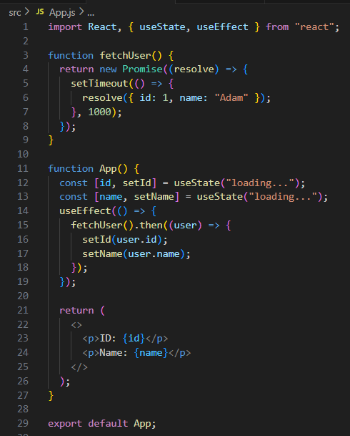
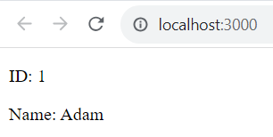
Performing initialization and cleanup actions – cont’d
Fetching component data – cont’d

Slide 18
Performing initialization and cleanup actions – cont’d
Canceling requests and resetting state:
Users will navigate your app and cause components to unmount before responses to their API requests arrive => an error occurs because the component will attempt to update the state values of a component that has been removed.
useEffect() Hook has a mechanism to clean up things such as pending API requests when the component is removed

Slide 19
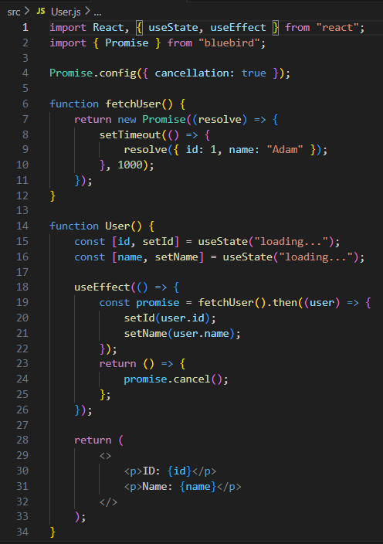

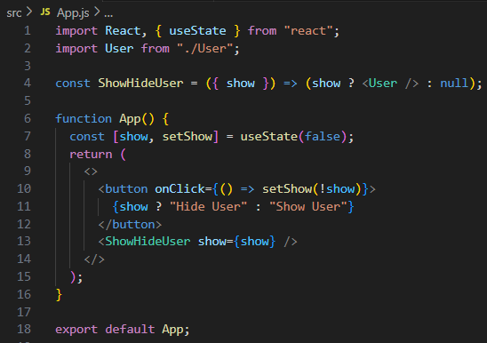
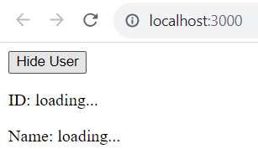
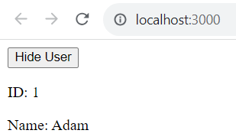
Performing initialization and cleanup actions – cont’d
Canceling requests and resetting state – cont’d

Slide 20
Performing initialization and cleanup actions – cont’d
Optimizing side-effect actions:
By default, React assumes that every effect that is run needs to be cleaned up. This typically isn't the case.
For example, you might have specific property or state values that require cleanup when they change. You can pass an array of values to watch as the second argument to useEffect()

Slide 21
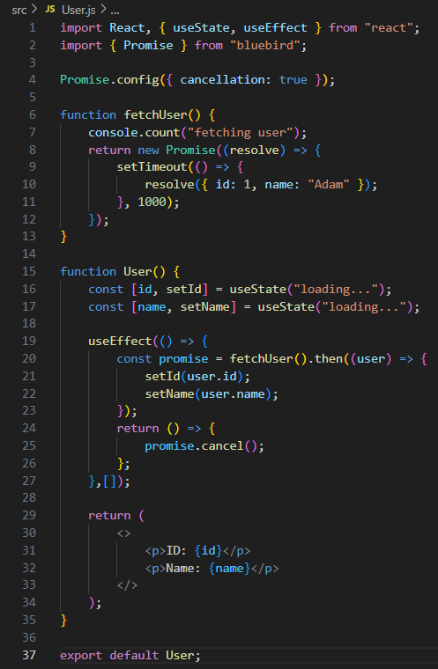
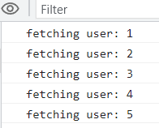
Performing initialization and cleanup actions – cont’d
Optimizing side-effect actions – cont’d
Add a second argument to useEffect(), an empty array => React that there are no values to watch and that we only want to run the cleanup code when the component is removed.
Add console.count('fetching user') to the fetchUser() function

Slide 22
Exercise 13: Demo about useEffect() Hook

Slide 23
Lifecycle of Reactive Effects

Slide 24
Lifecycle
Effects have a different lifecycle from components. Components may mount, update, or unmount.
An Effect can only do two things: to start synchronizing something, and later to stop synchronizing it.
This cycle can happen multiple times if your Effect depends on props and state that change over time.
React provides a linter rule to check that you’ve specified your Effect’s dependencies correctly.
This keeps your Effect synchronized to the latest props and state.

Slide 25
The lifecycle of an Effect
Every React component goes through the same lifecycle:
A component mounts when it’s added to the screen.
A component updates when it receives new props or state, usually in response to an interaction.
A component unmounts when it’s removed from the screen.
It’s a good way to think about components, but not about Effects.
An Effect describes how to synchronize an external system to the current props and state. As your code changes, synchronization will need to happen more or less often.

Slide 26
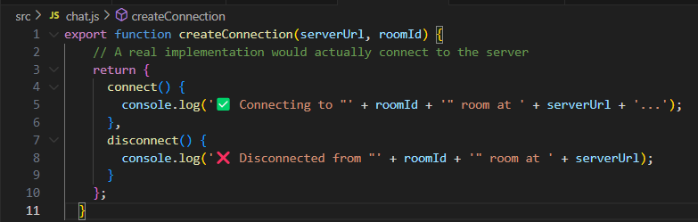
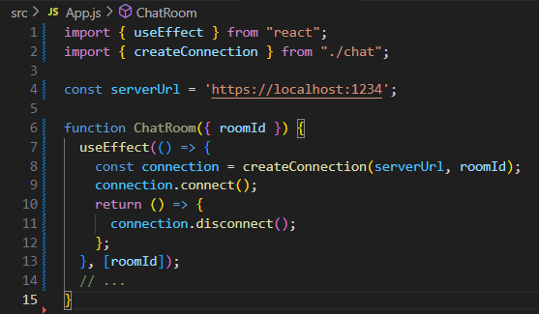
The lifecycle of an Effect – cont’d
Chat Server
Effect connecting your component to a chat server
how to start synchronizing
The cleanup function returned by Effect specifies how to stop synchronizing

Slide 27
Thinking from the Effect’s perspective
ChatRoom component’s perspective
ChatRoom mounted with roomId set to "general"
ChatRoom updated with roomId set to "travel"
ChatRoom updated with roomId set to "music"
ChatRoom unmounted
Effect did different things
Effect connected to the "general" room
Effect disconnected from the "general" room and connected to the "travel" room
Effect disconnected from the "travel" room and connected to the "music" room
Effect disconnected from the "music" room

Slide 28
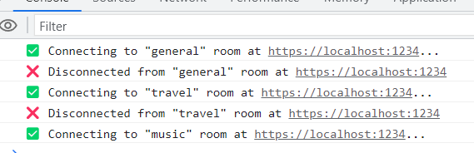
Always focus on a single start/stop cycle at a time
It shouldn’t matter whether a component is mounting, updating, or unmounting.
All you need to do is to describe how to start synchronization and how to stop it.
If you do it well, your Effect will be resilient to being started and stopped as many times as it’s needed.

Slide 29
Sharing data using context Hooks
React applications often have a few pieces of data that are global in nature.
For example, information about the currently logged-in user might be used in several places.
In cases like this, it makes sense to provide a context where this data can be easily accessed by components that are rendered in this context.
Sharing data using context Hooks:
Sharing fetched data
Updating stateful context data

Slide 30
Sharing data using context Hooks – cont’d
Sharing fetched data
Most of our components will directly fetch data that they and their children need.
In other cases, our app has some API endpoint with data that is used by several components throughout the application.
To share global data like this, you can use the React context API.
Components that are rendered within a context are able to access the data provided by the context.
Here is the UserContext context and the UserProvider component:

Slide 31
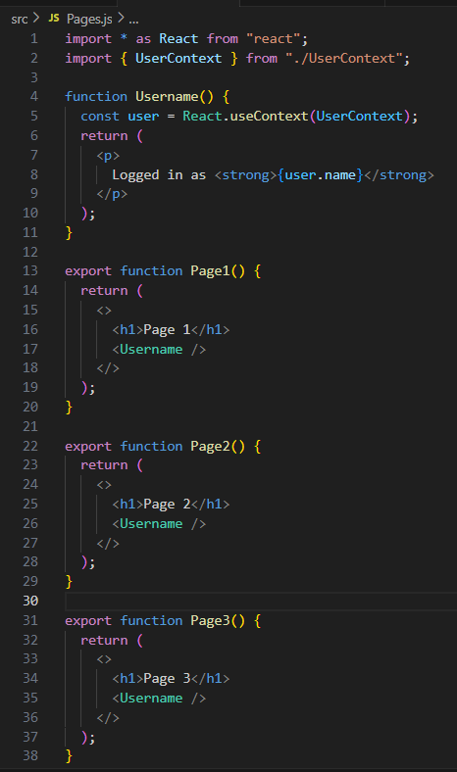
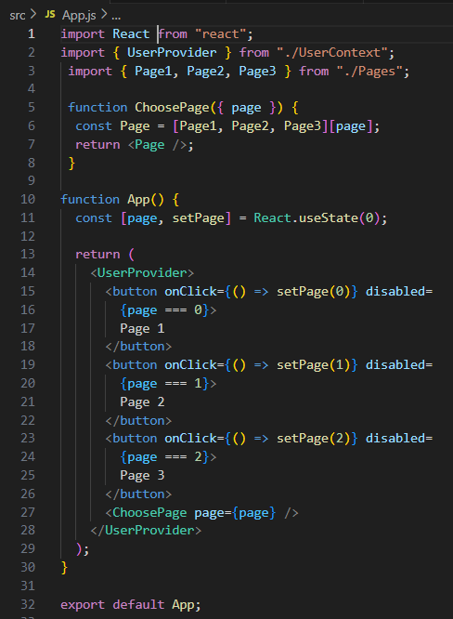
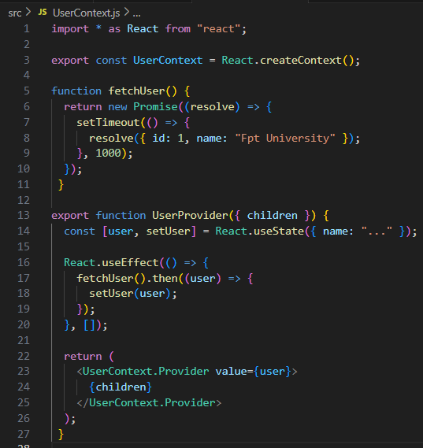
Sharing data using context Hooks – cont’d
Sharing fetched data – cont’d
the UserContext context and the UserProvider component
creating a simple App component with three pages
the page components that use context Hooks

Slide 32
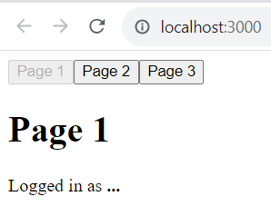
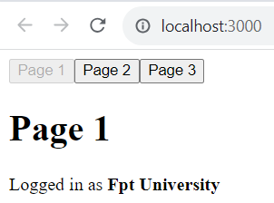
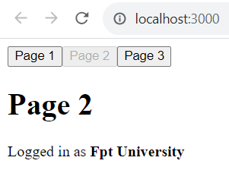
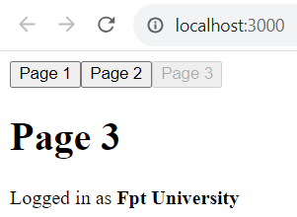
Sharing fetched data

Slide 33
Sharing data using context Hooks – cont’d
Updating stateful context data
Global data that is shared throughout application isn't limited to read-only API response data.
Sometimes, components themselves need to update global state values.
To enable this capability, we need to pass not only data from context producers but also a mechanism to update the data.
Since data stored in a context provider is a state created with useState(), we can just pass along the setter function, along with the state value.

Slide 34
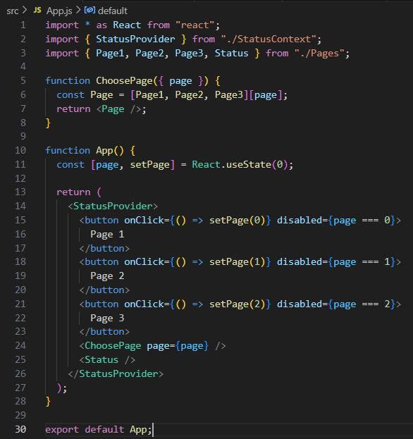
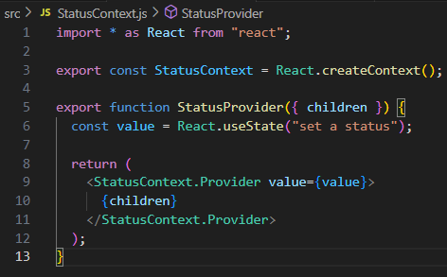
Sharing data using context Hooks – cont’d
Updating stateful context data – cont’d
StatusProvider component
two utility components that consume context data with useContext()

Slide 35
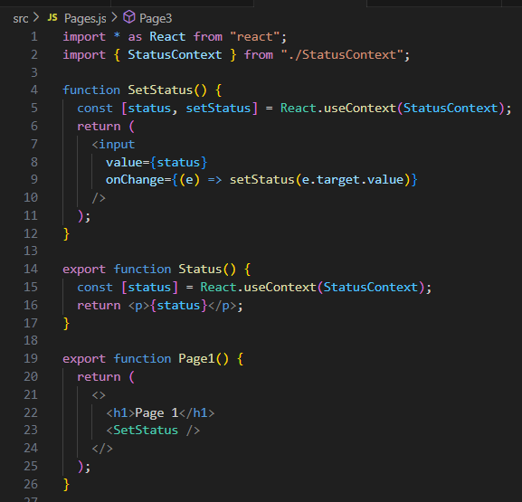
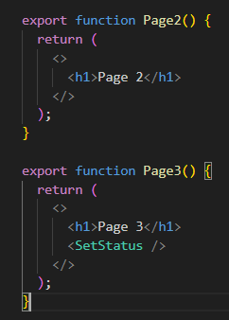
Sharing data using context Hooks – cont’d
Updating stateful context data – cont’d
page components that display and update the status context data

Slide 36
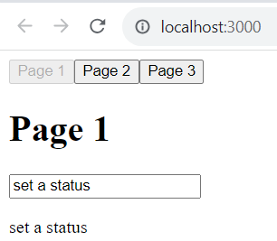
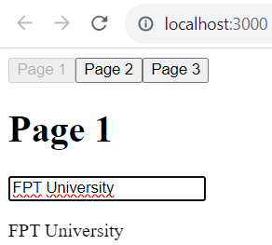
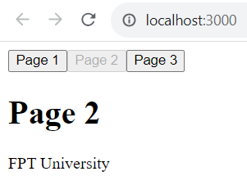
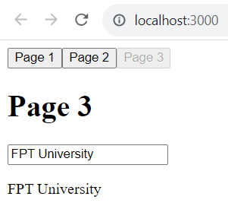
Updating stateful context data

Slide 37
Exercise 14: Demo about useContext() Hook

Slide 38
Using reducer Hooks to scale state management
The useState() Hook is a great way to manage the state of your component.
It can become a challenge to use this Hook when your component has a lot of related pieces of state.
With a lot of setter functions that you need to call individually, once you've figured out how a change in one state value affects another state value.
With reducers, you have one dispatch() function that's used to update the state of your component.
Using reducer with:
Using reducer actions
Handling state dependencies

Slide 39
Using reducer Hooks to scale state management – cont’d
Using reducer actions
A reducer function in a React application is a function that takes the current state, an action, and any other arguments that are needed to update the state.
It returns the new state of the component.
The action argument tells the reducer function what new state to return and is often used in a switch statement

Slide 40
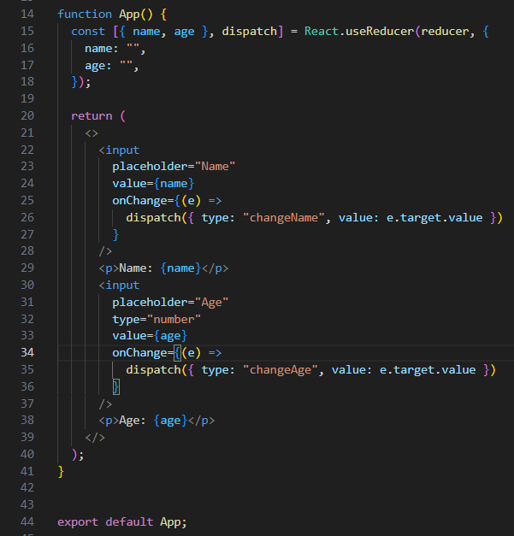
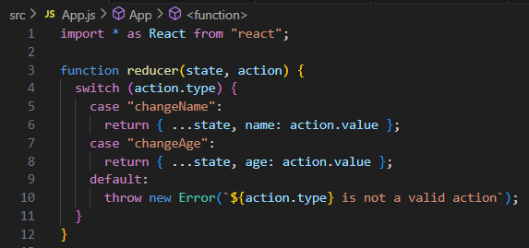
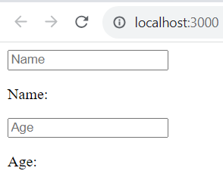
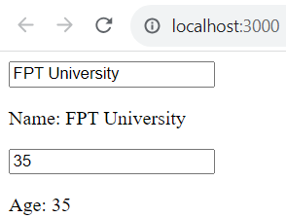
Using reducer Hooks to scale state management – cont’d
Using reducer actions

Slide 41
Using reducer Hooks to scale state management – cont’d
Handling state dependencies
This Hook comes with the assumption that when a state needs to be updated, it's one piece at a time.
Let's look at an example that allows the user to select an item and the quantity of that item. This means that whenever the quantity or item fields change, the total must also change.

Slide 42
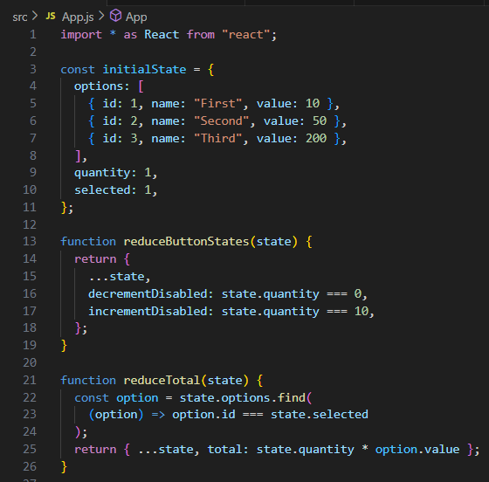
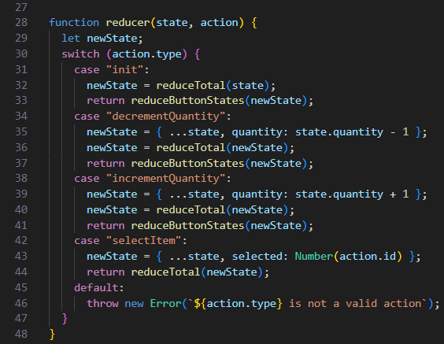
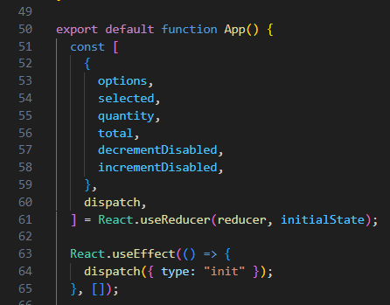
Using reducer Hooks to scale state management – cont’d
Handling state dependencies

Slide 43
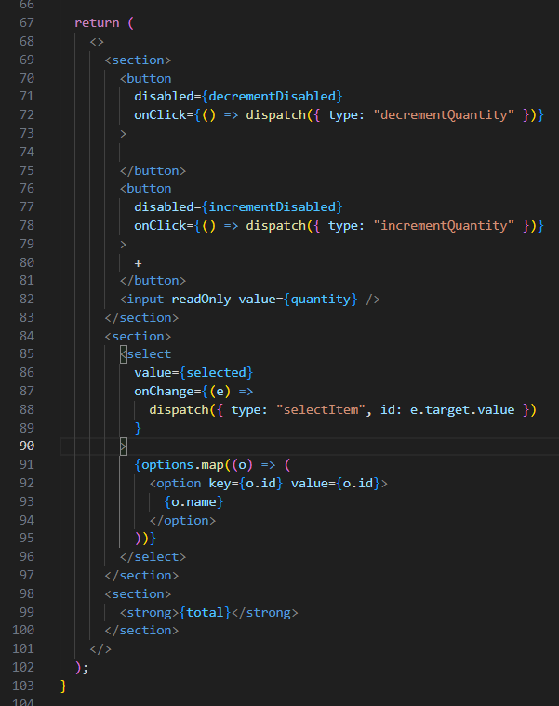
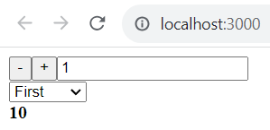
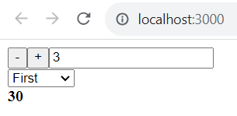
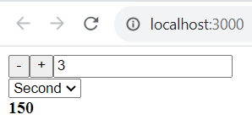
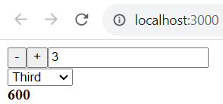
Using reducer Hooks to scale state management – cont’d
Handling state dependencies

Slide 44
Exercise 15: Demo about useReducer() Hook

Slide 45
Lab 4: Demo about all Hooks

Slide 46
Summary
Concepts were introduced:
Describe about Hooks?
Rule of Hooks?
Describe about Built-in Hooks, Custom Hooks
Maintaining state using Hooks
Performing initialization and cleanup actions
Sharing data using context Hooks
Using reducer Hooks to scale state management

